Slide 1

Sales Performance Report
Presented by
DA Group 5
Aqsa Shuja | Iris Engler | Stephy Zhu | Sujata Banerjee

Slide 2
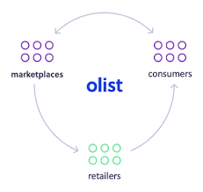
What is Olist?
Olist is a Brazilian company founded in 2015.
It operates as an online e-commerce site that connects shops to wider marketplaces.
The company is pioneer in business model called “Marketplace of Marketplaces”.
It does not hold any inventory or sell products of its own.
Products are sent directly from merchant stores to clients around the country.

Slide 3
Agenda
Generate business insights, investigate improvements to the Company’s processes and analyze e-commerce performance.

Slide 4
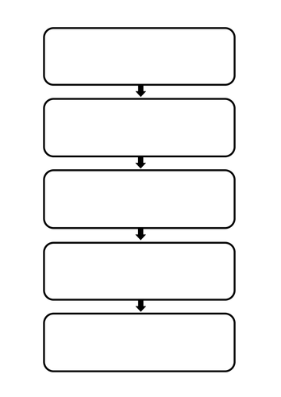
Tools and Software:
MS Power Bi Desktop - Version: 2.114.864.0 64-bit (February 2023)
MS-Excel - Microsoft 365
Data Source
Brazilian E-Commerce Public Dataset by Olist | Kaggle
The dataset contains information regarding 100k orders from 2016 to 2018.
Data Range : 15/09/2016 to 03/09/2018.
Power Bi Dashboard Contents:
OVERVIEW
SALES
FORECASTS
DELIVERY
REVIEWS

Slide 5
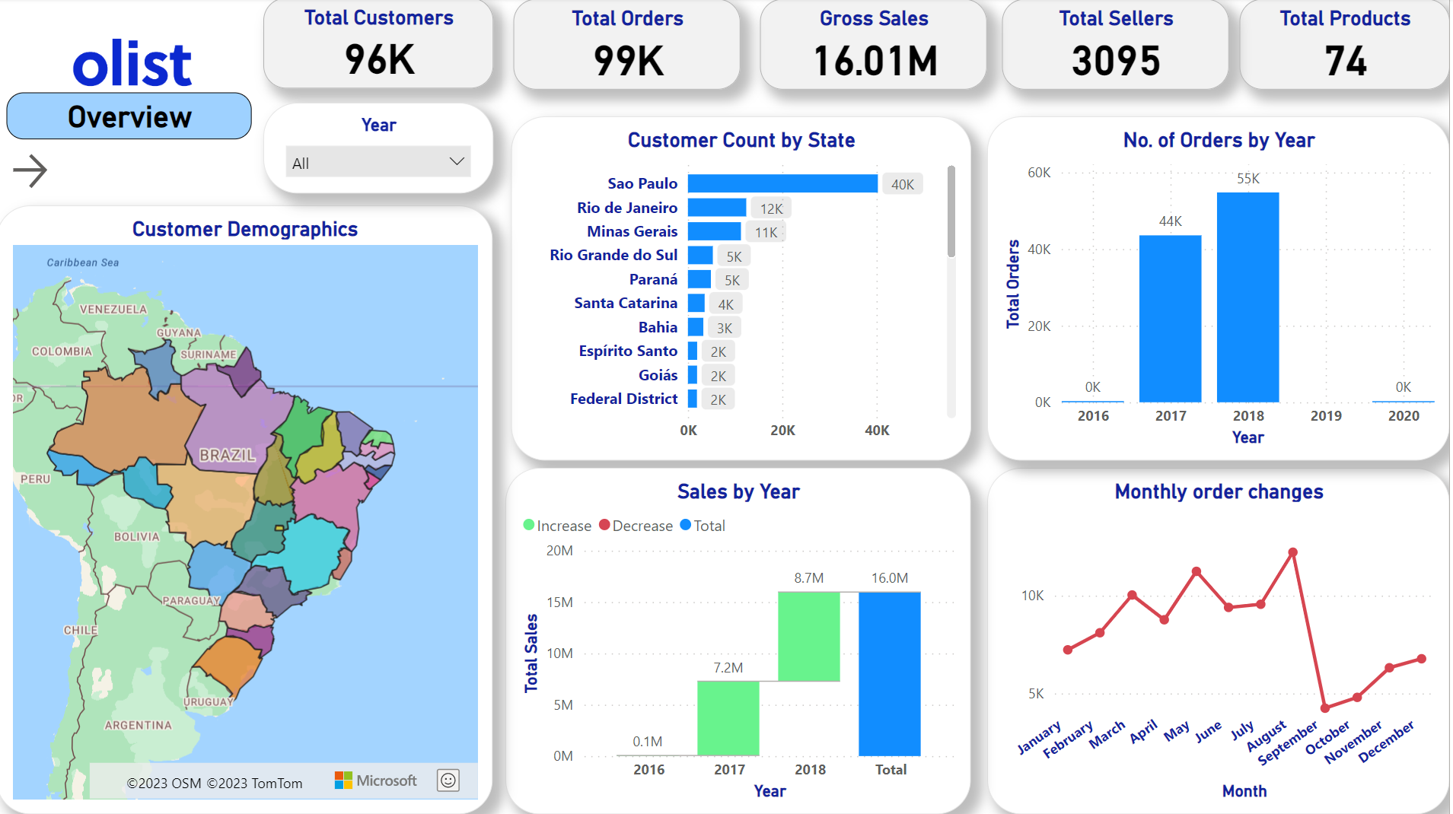
Business Overview Page

Slide 6
Customers by State

Slide 7
Number of orders increased by 20% in 2018.
Highest number of orders are placed in the month of August.

Slide 8
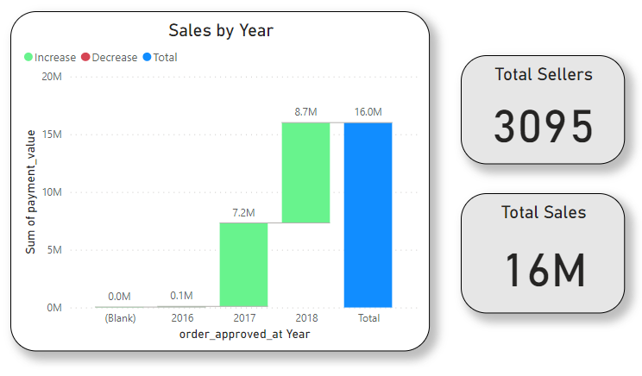
Sales by Year
Sales increased by 9% in 2018

Slide 9
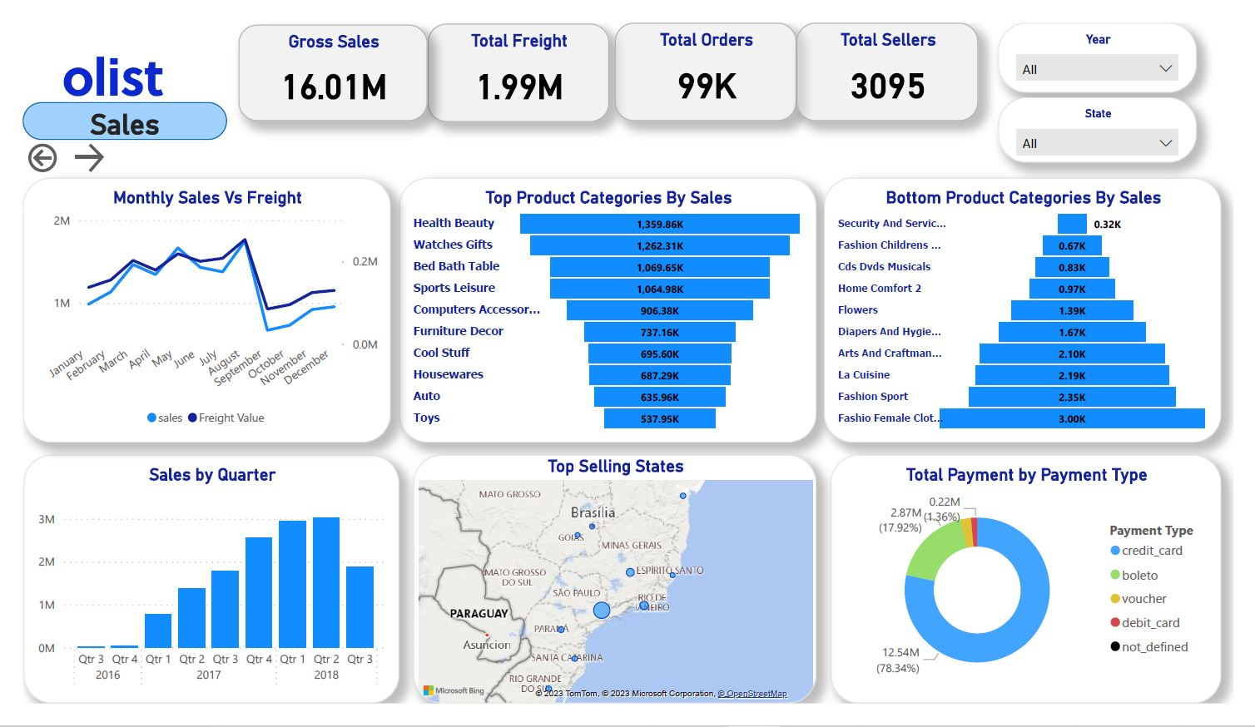
Sales

Slide 10
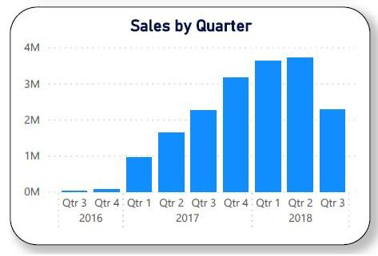
Sales by Quarter
Orders have increased steadily over time

Slide 11
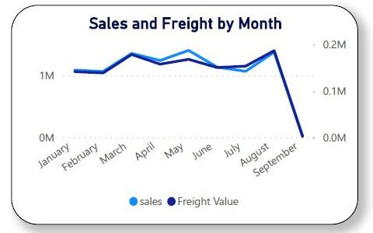
Sales and Freight by Month
High correlation between sales total and delivery charges

Slide 12
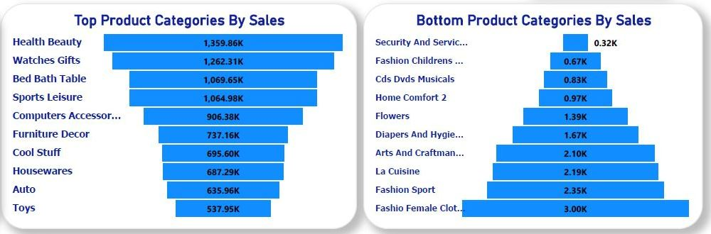
Top and Bottom Categories
The top 4 categories are Health & Beauty, Bed, Bath & Table, Watches & Gifts and Sports & Leisure.

Slide 13
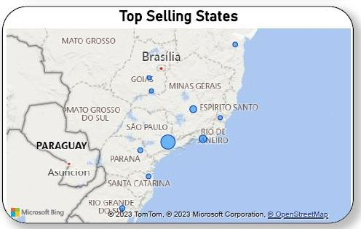
Top Selling States
Top selling states are São Paulo, Rio de Janeiro and Espírito Santo.

Slide 14
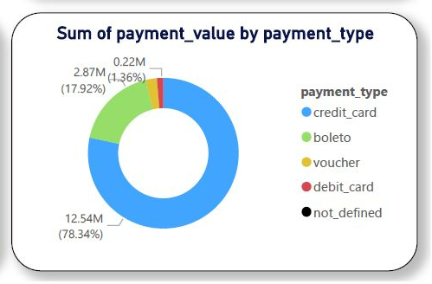
Payment Types Used
Credit card and Boleto payments account for over 95% of sales

Slide 15
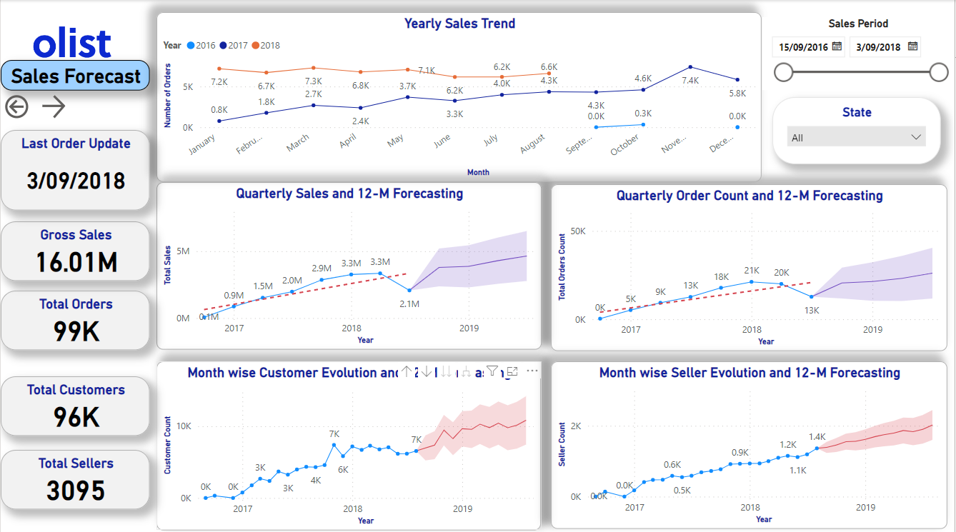
Sales Forecast

Slide 16
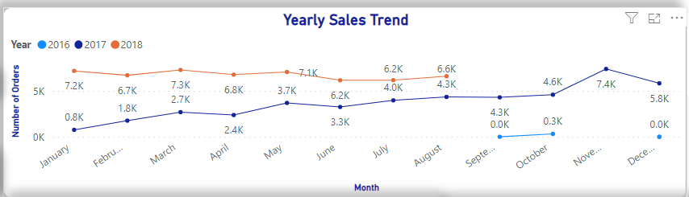
Yearly Sales Trend
Data available from sales period 15-09-2016 to 03-09-2018.
2017-2018 had an overall positive monthly trend for the total number of orders.
2017 shows a steady positive trend with highest number of orders placed (7395) in Q4.
2018 shows a flat trend with a decrease in sales in the Q3 as only 8 months of data is available.

Slide 17
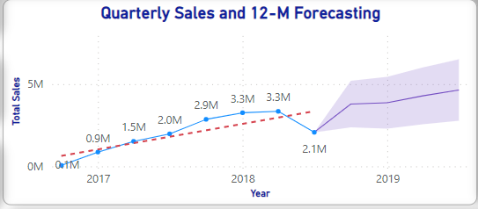
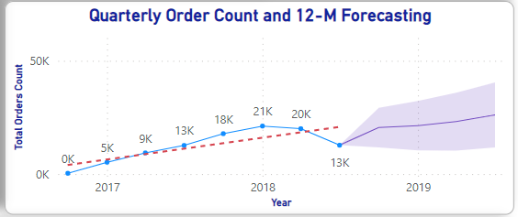
Quarterly Sales and Order Performance and 12-M Forecasting
2017-2018 had a positive quarterly trend in Sales growth and order counts.
Decrease in sales and order in 2018 Q3 is due to only 8 months available historical data.
Forecast prediction with 95% confidence interval.
27% increase in sales predicted in 12 Month forecast from 2018 Q2 from 3345864.65R$ to 4642562.75R$.
23% increase in order counts predicted in 12 Month forecast from 2018 Q2 from 20008 to 26120.

Slide 18
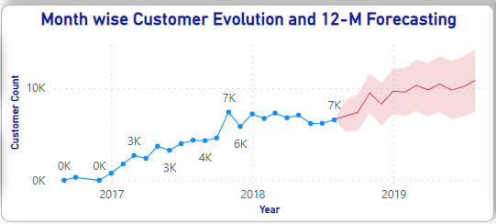
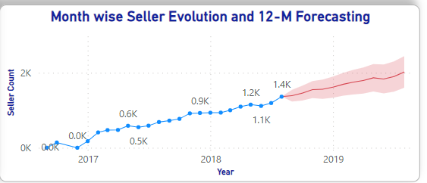
Monthly Customer acquisition | Seller subscription and 12-M Forecasting
2017-2018 had a Positive monthly trend in customer acquisition and Seller subscription.
Forecast prediction with 95% confidence interval.
The 12-M forecast from 2018 Q3 till 2019 Q3 predicted an increase in Customer growth of upto 10833 i.e 39.5% more than the existing count (6549).
The 12-M forecast predicted an increase in Seller subscription upto 2022 i.e 32.5% more than the existing 2018 Q3 count(1363).

Slide 19
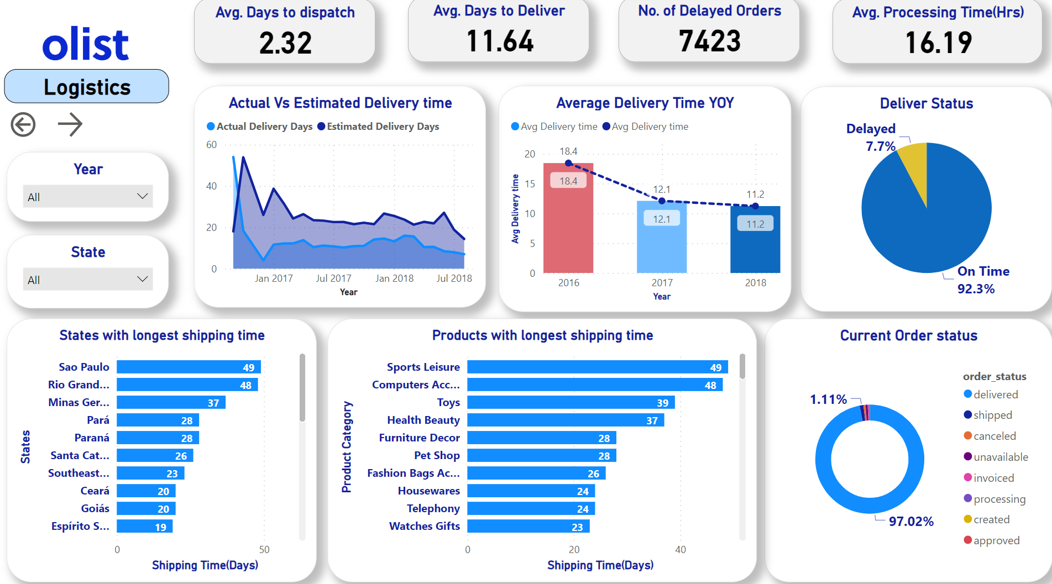
Logistic Performance Page

Slide 20
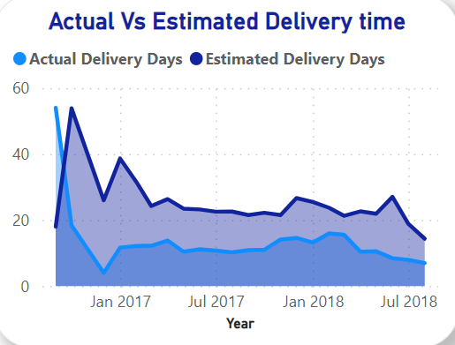
Logistic Performance
Notes:
The estimated time at the beginning of 2016 was set pretty low, and much less than

Slide 21
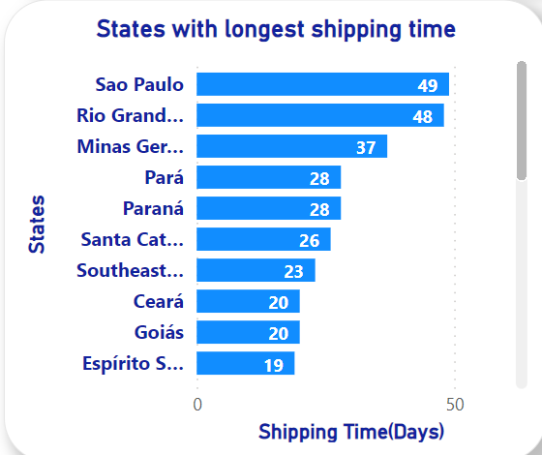
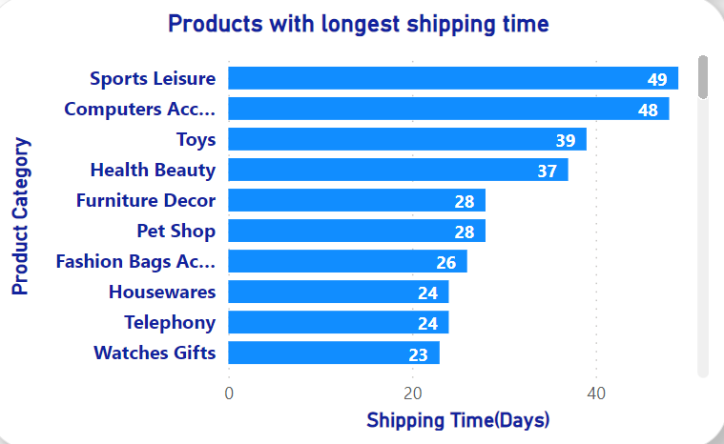
Logistic Performance

Slide 22
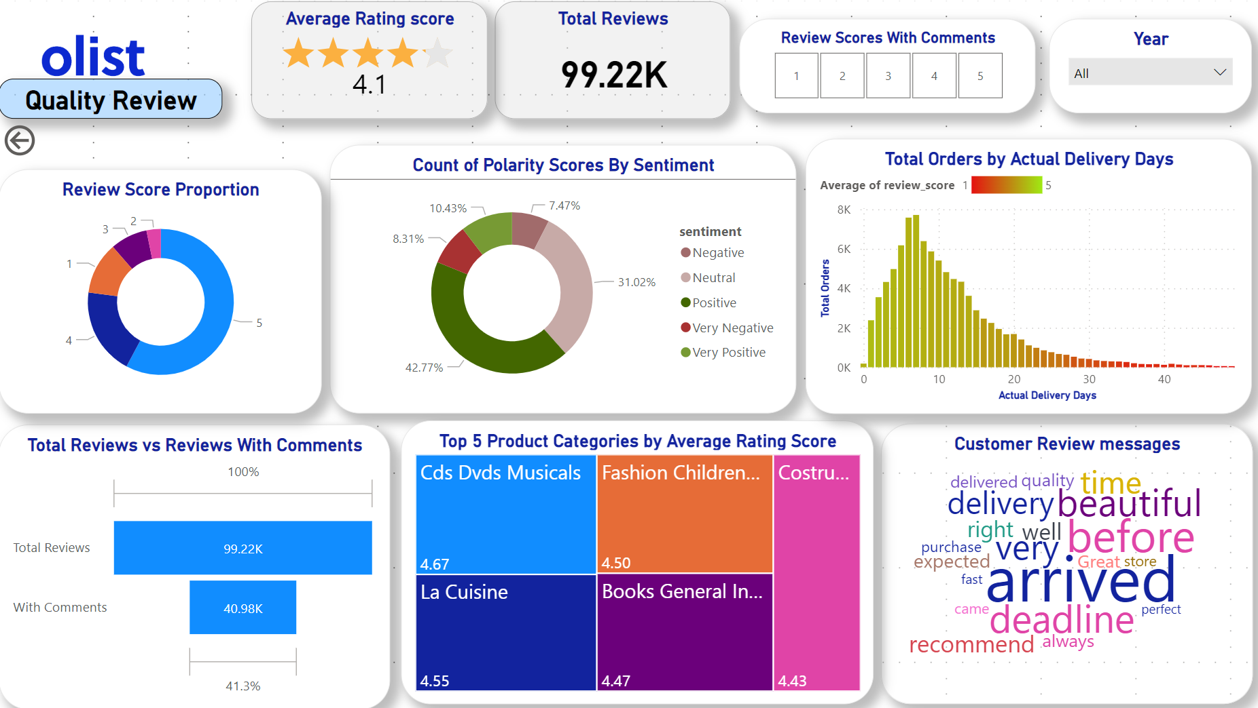
Quality Review Page

Slide 23
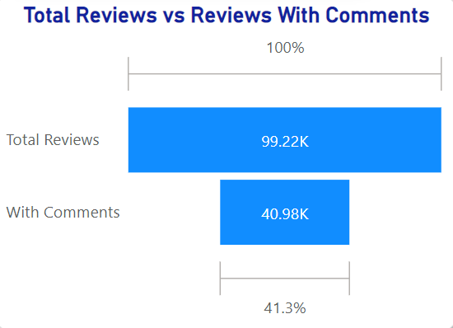
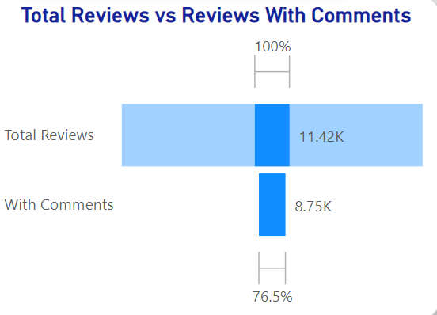
Reviews with comments proportion
Total reviews vs reviews with comments
Proportion for only 1 star reviews

Slide 24
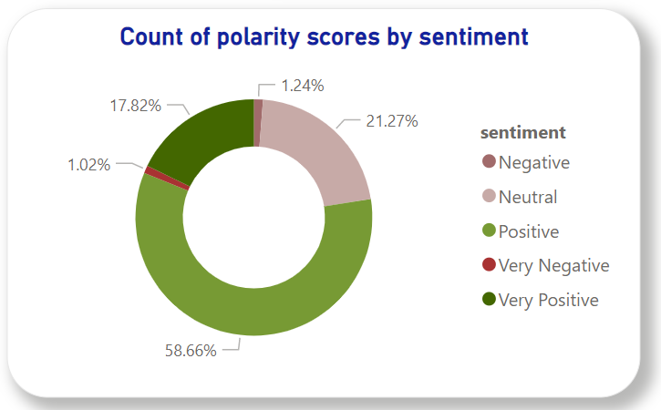
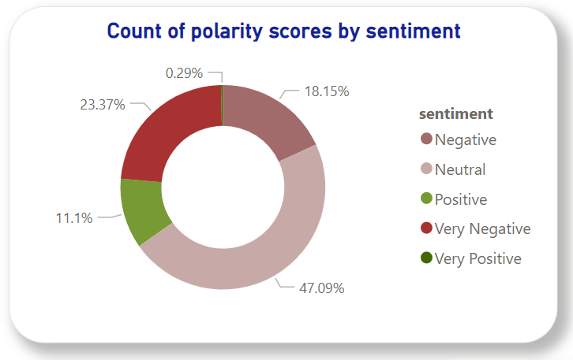
Sentiment Analysis on Customer Reviews
Sentiment distribution - rate score 5
Sentiment distribution - rate score 1

Slide 25
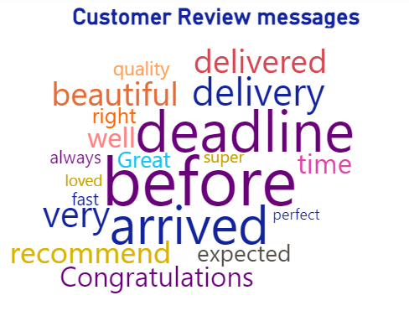
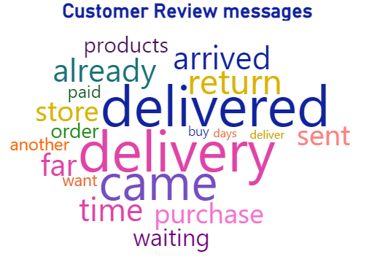
Word Cloud
Word Cloud - rate score 5
Word Cloud - rate score 1

Slide 26
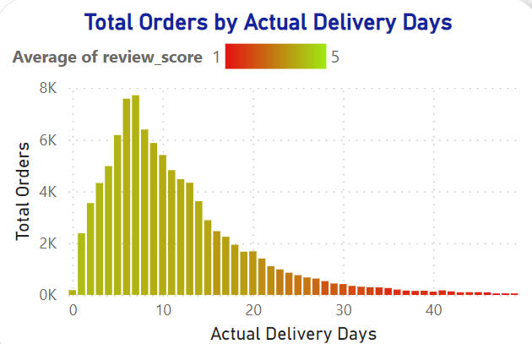
Customer Review Analysis
Customer satisfaction rate is closely related to delivery durations

Slide 27
How is the business performing?
60% of yearly sales are generated from only the top 10 products.
Average delivery time is a period of 11 days.
Long shipping time from major states like Sao Paulo.
Low review score for product delivery due to long shipping time or lost deliveries.
Notes:
-Inventory review - 60% sales from 10% products,

Slide 28
Recommendations
Inventory review
Warehouse set up in states with longer transit times
Delivery tracking system

Slide 29
Thank You

